Slide 1
CIVE 320
Construction Materials & Technology
Slides Set: 5-a
Asphalt Binder: An Introduction
Dr. Ghassan Chehab

Slide 2
Asphalt Types
Bitumen
Asphalt
Tar
Petroleum-Based
Natural Deposits
AC + petroleum solvent:
Slow, Med., & Rapid Curing
Cutbacks
Emulsifiers
AC + Water + Agent:
Anionic or Cationic
Asphalt Cement
Different Grades

Slide 3
Petroleum-Based Asphalts
Asphalt is waste product from refinery processing of crude oil:
  Sometimes called the “bottom of the barrel”
  0.05$/Gal
Properties depend on:
  Refinery operations
  Crude source
Barrel of Crude Oil
Gasoline
Kerosene
Lt. Gas Oil
Diesel
Motor Oils
Asphalt
Notes:
A number of products are obtained from one barrel of crude. Asphalt cement is what is left after the more volatile products are removed and it is commonly referred to as the “bottom of the barrel”.

Slide 4


Refinery Operation
LIGHT DISTILLATE
PUMPING
STATION
MEDIUM DISTILLATE
FIELD STORAGE
HEAVY DISTILLATE
TOWER
DISTILLATION
REFINERY
RESIDUUM
PROCESS
UNIT
OR
STORAGE
TUBE
HEATER
CONDENSERS
AND
COOLERS
ASPHALT
CEMENTS
GAS
PETROLEUM
AIR
BLOWN
ASPHALT
FOR PROCESSING INTO
EMULSIFIED AND
CUTBACK ASPHALTS
SAND AND WATER
AIR
STILL
Notes:
Distillation is used to separate the various crude fractions by boiling point ranges. The crude oil is heated in a large furnace to about 343 ºC and partially vaporized. The remaining material is transferred to a distillation tower. Different fractions reach their boiling point ranges at various heights in the tower. When the temperature is reduced, each material condenses on a tray and is drawn off at each level.

Slide 5
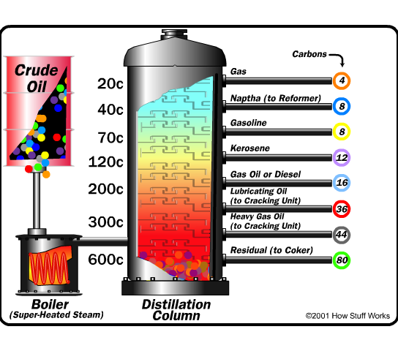
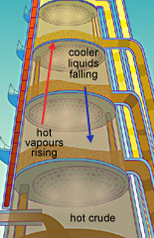
Fractional Distillation

Slide 6
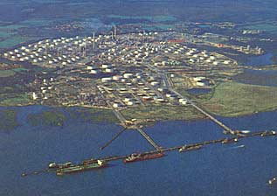
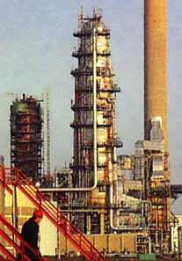
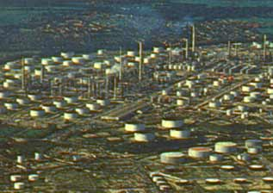
Fawley Refinery, UK
Largest in Europe

Slide 7

Refineries and Oil Rigs in Rita’s Path

Slide 8
Molecular Structure
Asphaltenes
discrete phase
  high MW (C/H >0.8)
  aromatics w/few side chains
Resins
compatibilize asphaltenes
  intermediate MW, C/H >0.6
  more side chains
Oils
continuous phase
  lightest MW, C/H <0.6
  primarily aliphatics
Resin-covered asphaltenes floating in an oil base

Slide 9
Molecular Structure
Asphaltines
Resins
Oils

Slide 10
Cutbacks
Rapid cure (RC) (Naphtha or Gasoline)
  High volatility of solvent
  Tack coats, surface treatments
Medium cure (MC) (Kerosene)
  Moderate volatility
  Stockpile patching mix
Slow cure (SC) (Low viscosity oil)
  Low volatility
  Prime coat, dust control
Notes:
Cutbacks are liquid at room temperature and are manufactured by adding or “cutting” asphalt cements with petroleum solvents. The volatility of the solvent dictates the rate at which the solvent evaporates. How fast the solvent escapes into the atmosphere regulates how fast a mixture of cutback and aggregate will set. Environmental regulations are increasingly limiting the use of these products.

Slide 11

Cutback Types & Composition
GRADE
NAPTHA FOR RC
KEROSENE FOR MC
LIGHT OIL FOR SC
30 70 250 800 3000
SOLVENT
ASPHALT CEMENT
APPRX. FUROL VIS., 140°F, SEC.
APPROX. KINEMATIC VIS. 140°F, CS
30% solvent
10% solvent

Slide 12
Emulsions
Emulsifier gives surface charge to asphalt droplets suspended in water medium
  Anionic
    Negative charge
    Alkaline
    Good with limestone (positive charge)
  Cationic
    Positive charge
    Acid
    Good with silica gravels (negative charge)
Notes:
Emulsions are produced by blending asphalt cements, water and an emulsifier (e.g. soap) in a high shear colloid mill. The resulting asphalt droplet suspended in the water has a charge which reflects the chemistry of the emulsifier. The charge of the emulsion is usually selected so that it is opposite that of the aggregate to promote adhesion of the asphalt to the aggregate surface.
Emulsions are an asphalt-based product which is also liquid at room temperature.

Slide 13
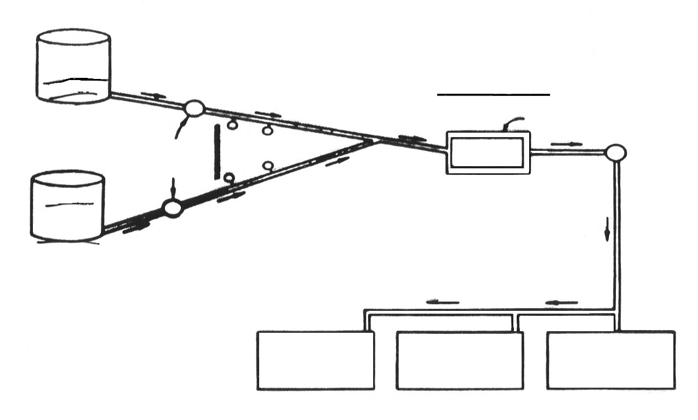
Manufacture of Asphalt Emulsions
HOT
ASPHALT
TANK
COLLOID MILL
STATOR
PUMP
ROTOR
PUMP
WATER
EMULSIFIER
Clearance
0.005 - 0.030”
STORAGE
STORAGE
STORAGE

Slide 14
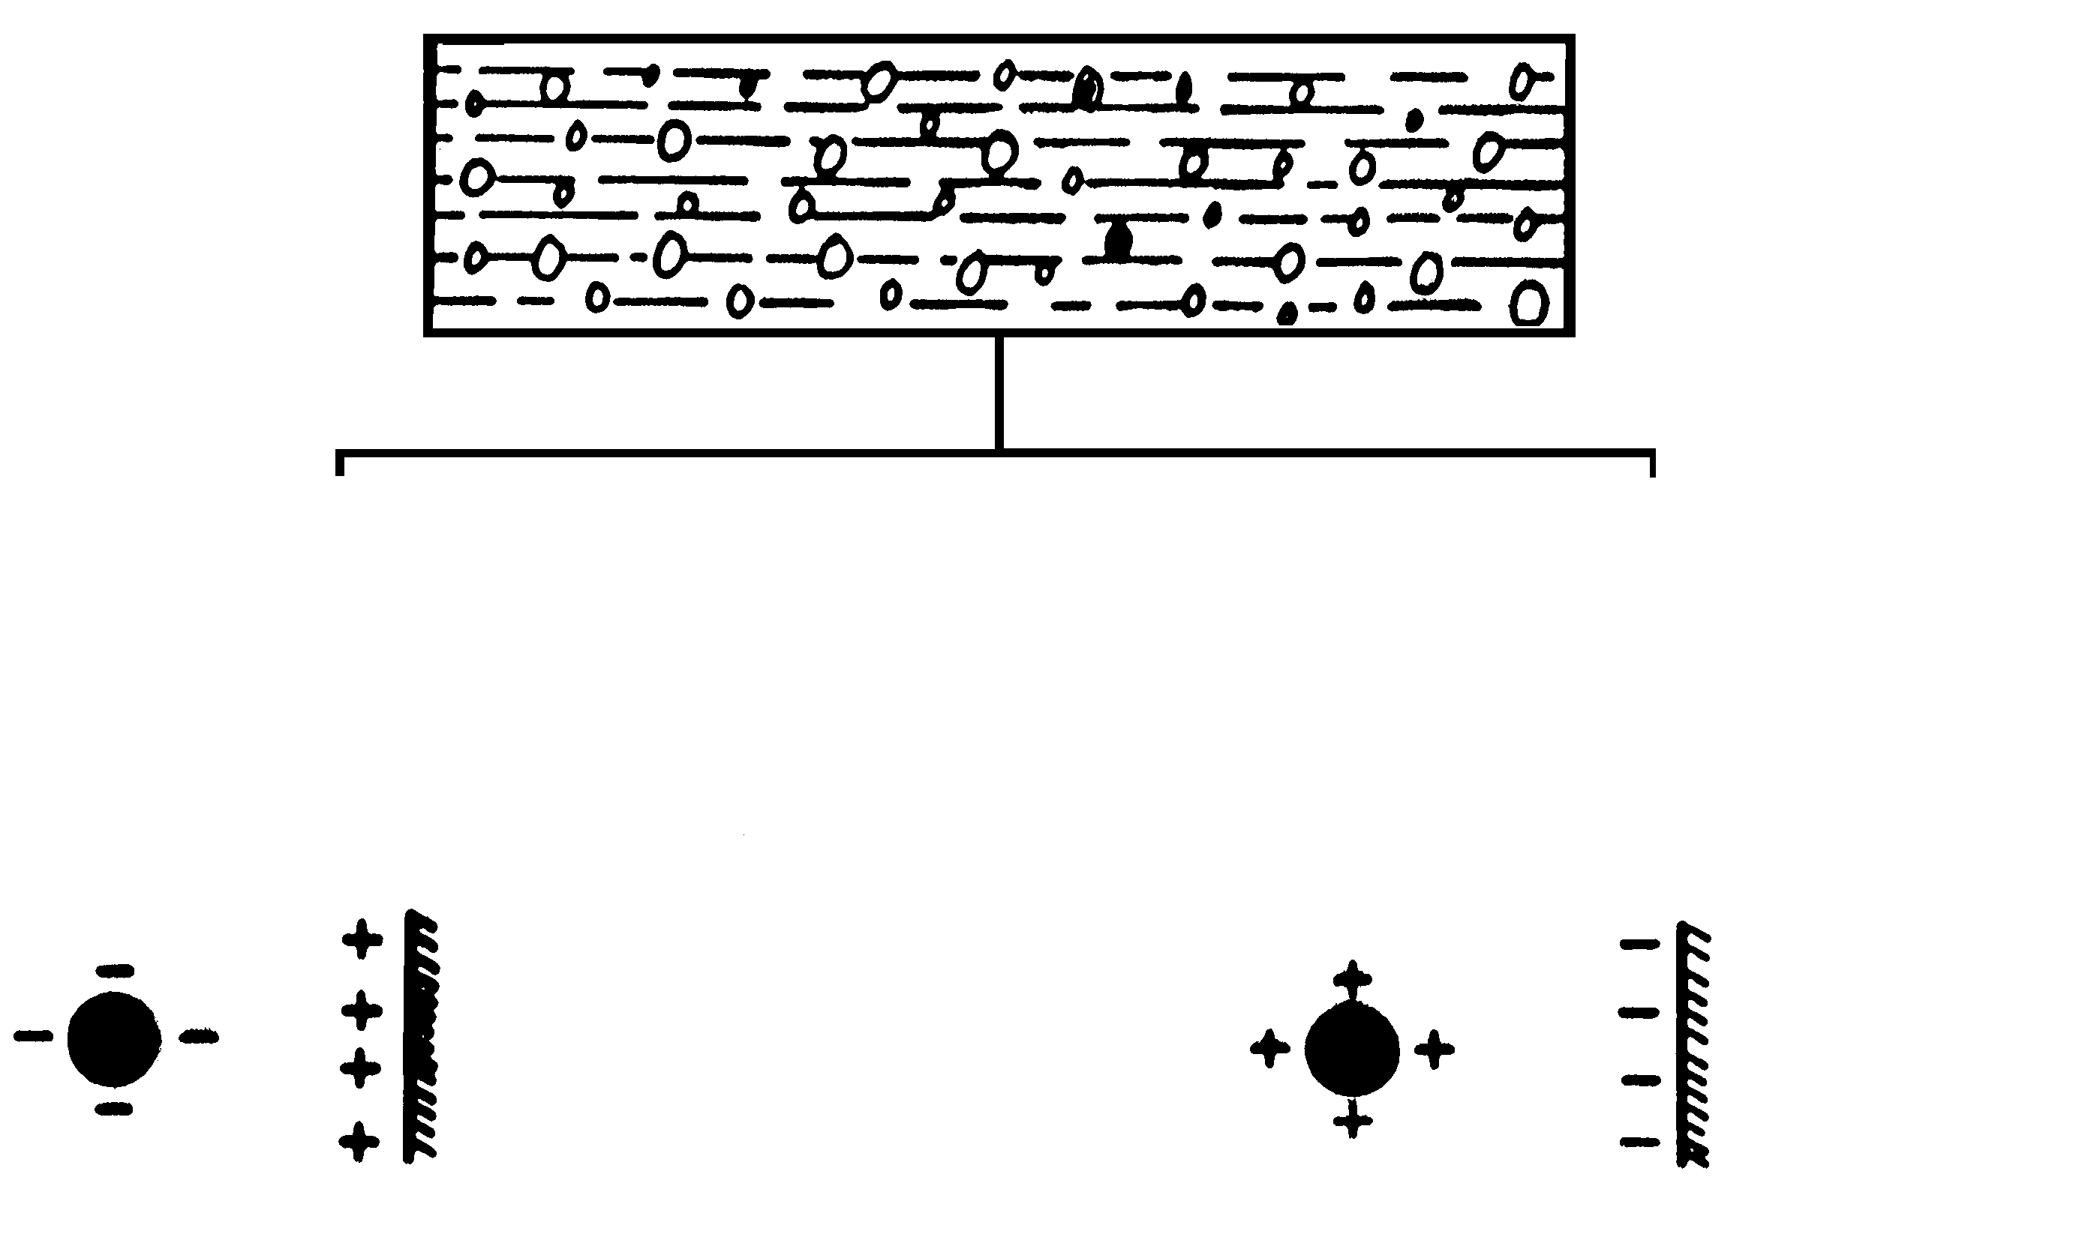
Emulsions: Chemical Activity
ASPHALT
+
WATER
+
EMULSIFIER
ANIONIC
(-)
ALKALINE
CATIONIC
(+)
ACID
SILICA
(Sil. Gravel)
LIMESTONE

Slide 15

Emulsion Types & Applications
Emulsions
RAPID SETTING (RS)
Tack Coat
Surface Treatment
(spray applications)
SLOW SETTING (SS)
Road Mix (dense)
Slurry Seals
Tack Coat
Fog Seal
MEDIUM SETTING (MS)
Road Mix (open-graded)
weaker surface charge
more emulsifying agent

Slide 16
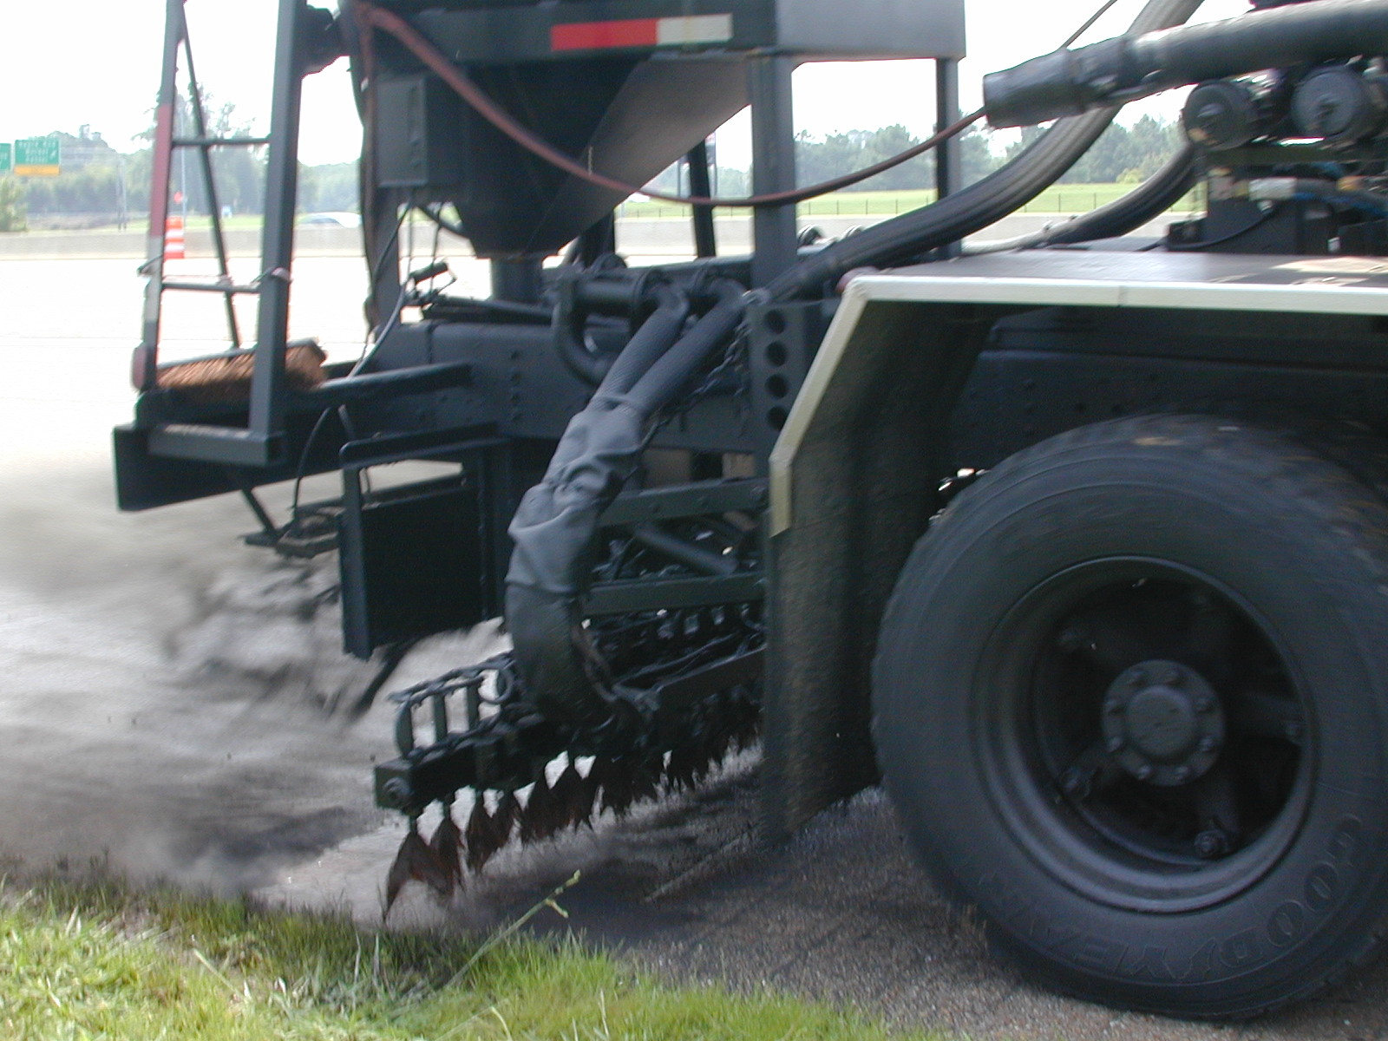
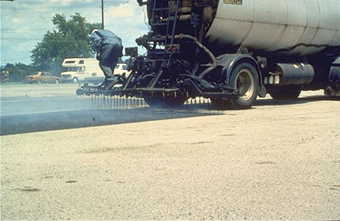
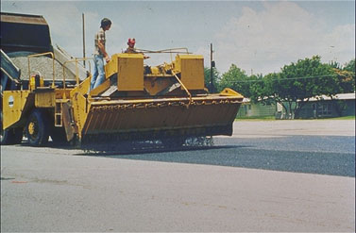
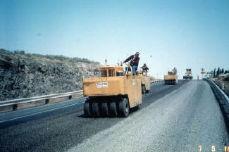
Emulsions in Surface Treatments

Slide 17


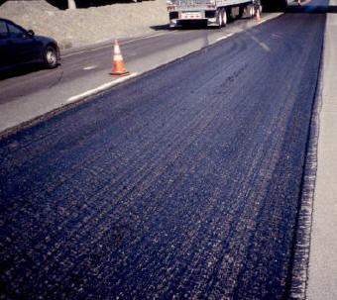
Emulsion Breaking

Slide 18
Fiber-Reinforced Surface Treatments
Demo at PTI Test-track

Slide 19
Aging
Hardening
  Long-Term
  Changes in properties (chemical and physical) over time
  MW & quantity of solvents decreases
  Irreversible
Volatilization
  Short term
  Volatile components (lighter petroleum products) evaporate
  During mixing and construction
  Irreversible

Slide 20
Aging, cont’d
Oxidation
  Long-term
  Organic molecules react with oxygen
  Occurs faster in warmer climates
  Irreversible
Molecular Structuring
  Reversible - overcome by heating

Slide 21
Simulating Aging
Thin-Film Oven Test (TFO)
  5 hours, 163C
Rolling Thin-Film Oven Test (RTFO)
  85 min, 163C
  Simulates short-term aging
Pressure Aging Vessel (PAV)
  300psi, 90-110C, 20 hours
  Simulates long-term aging
Notes:
Explain the differences between short term and long term aging processes

Slide 22
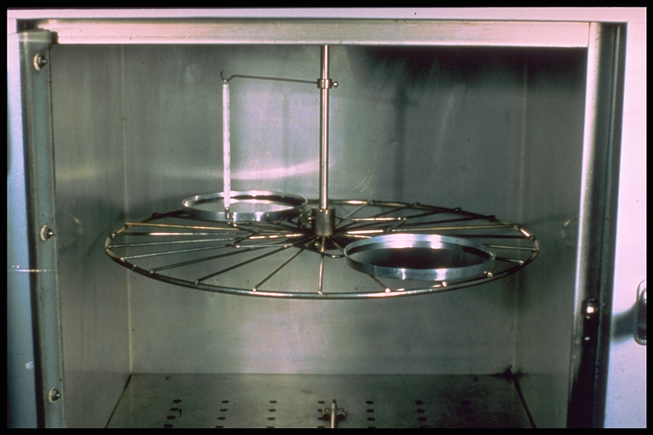
Thin Film Oven Test
Purpose
  To subject asphalt to hardening conditions approximating those that occur in normal HMA batch plant operations.
Test (ASTM D1754)
  Forced draft oven (325°F)
  Rotating shelf (5-6 RPM)
  1/8” film of Asphalt heated in pans
  Time: 5 hours
  Weight loss determined (%)
  Viscosity or penetration of
  TFOT residue measured
Notes:
The thin-film oven (TFO) test simulates short-term aging by heating a film of asphalt binder in an oven for 5 hours at 163° C (325° F). The effects of heat and air are determined from changes incurred in physical properties measured before and after the oven treatment by other test procedures.

Slide 23
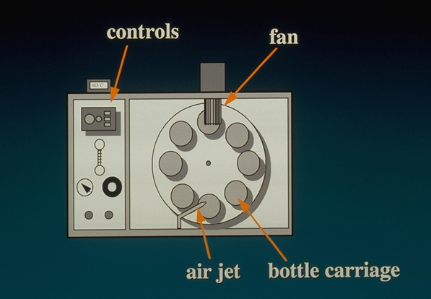
Rolling Thin Film Oven Test (RTFOT)
Purpose
  To subject asphalt to hardening conditions approximating those that occur in normal HMA batch plant operations.
Test (ASTM D2872)
  Forced draft oven (325°F)
  Moving thin film in glass bottle
  Rack rotates at a prescribed rate
  Air jet (air flow 4000 ml/min)
  Time: 75 minutes
  Weight loss measured
  Viscosity of RTFOT residue measured
Notes:
The rolling thin-film oven (RTFO) test simulates short-term aging by heating a moving film of asphalt binder in an oven for 85 minutes at 163° C (325° F). The effects of heat and air are determined from changes incurred in physical properties measured before and after the oven treatment by other test procedures. The moving film is created by placing the asphalt binder sample in a small jar then placing the jar in a circular metal carriage that rotates within the oven.
The RTFO test is generally considered superior to the TFO because:
It achieves the same degree of hardening (aging) in less time (85 minutes vs. 5 hours)
It uses a rolling action that:
Allows continuous exposure of fresh asphalt binder to heat and air flow
Allows asphalt binder modifiers, if used, to remain dispersed in the sample
Prevents the formation of a surface skin on the sample, which may inhibit aging
Although it has been in common use by some western states for some time, Superpave adopted the RTFO test to simulate short-term asphalt binder aging.

Slide 24
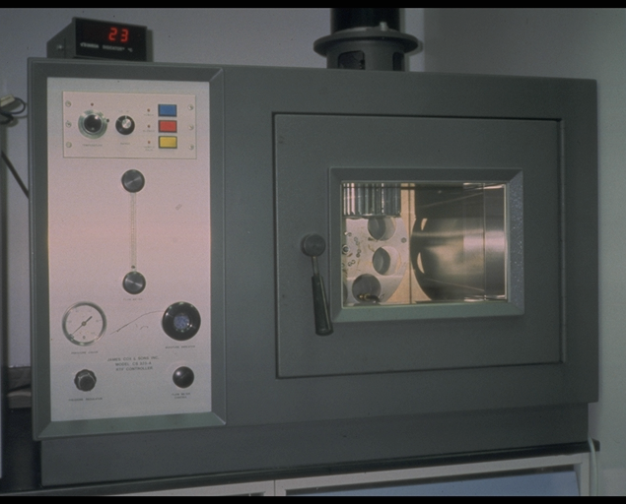
Rolling Thin Film Oven (RTFO)

Slide 25
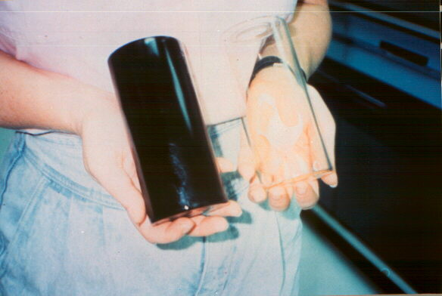
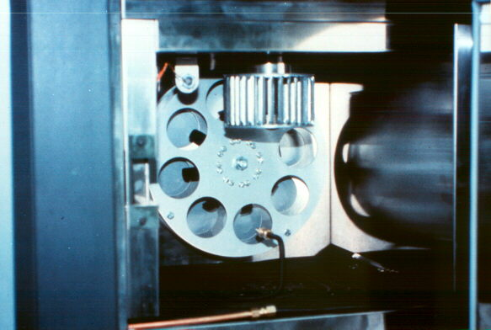
Inside of RTFO
Opening in Bottle
Before
After
Fan
Rotating Bottle Carriage
Air Line

Slide 26
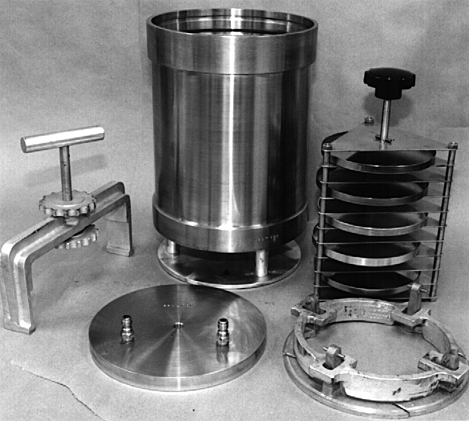
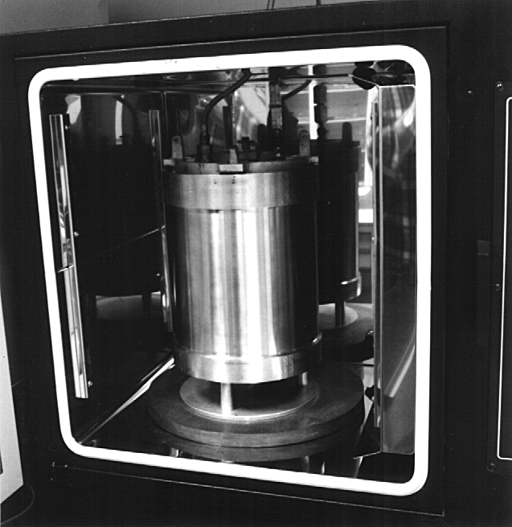
Pressure Aging Vessel (PAV)
(Long Term Aging)
Simulates aging of an asphalt binder for 7 to 10 years
50 gram sample is aged for 20 hours
Pressure of 2,070 kPa (300 psi)
At 90, 100 or 110 C
Rack of individual pans
(50g of asphalt / pan)
Bottom of pressure aging vessel
Oven
Vessel Lid Components
Notes:
The pressure aging vessel (PAV) was adopted by Superpave to simulate the effects of long-term asphalt binder aging that occurs as a result of 5 to 10 years HMA pavement service (Bahia and Anderson, 1994).
Prior to Superpave, the general concept of the pressure aging vessel had been used for many years in rubber product aging. The PAV is an oven-pressure vessel combination that takes RTFO aged samples and exposes them to high air pressure (2070 kPa (300 psi)) and temperature (90° C (195° F), 100° C (212° F)° or 110° C (230° F) depending upon expected climatic conditions) for 20 hours.
Aging the asphalt binder samples at pressure is advantageous because:
There is a limited loss of volatiles
The oxidation process can be accelerated without resorting to extremely high temperatures

